Slide 1
Predicitive analysis for accident prevention and response

Slide 2
Team members
B V Drakshayani – 204M1A0510
Sujith pamujala – 214M5A0508

Slide 3
INTRODUCTION
This is a multiclass classification project to classify the severity of road accidents into three categories. This project is based on real-world data, and the dataset is also highly imbalanced.
There are three types of injuries in a target variable: minor, severe, and fatal.Road accidents are the major cause of unnatural deaths around the world.
All governments work hard to raise awareness about the rules and regulations that must be followed when driving a vehicle on the road in order to reduce fatalities.
Thus, it is necessary to have a mechanism that predicts the severity of such accidents and helps in reducing fatalities.

Slide 4
Problem statement
The target feature is “Accident_severity,” which is a multi-class variable. The task is to classify this variable based on the other 31 features step-by-step by going through each data science process and task. Our metric for evaluation will be your “F1 score.”

Slide 5
Scope of the project
Losses in road accident are unbearable, to the society as well as a developing country like us. So, it has become an essential requirement to control and arrange traffic with advanced system to decrease the number of road accidents in our country. By taking simple precautions, based on prediction of a sophisticated system may prevent traffic accidents.
Moreover, to tackle this situation where everyday so many people were killed in a traffic accident and day by day this rate is getting increased. The implementation of machine learning is a functional and a great approach to take an accurate decision with the experience to manage the current situation and the findings of analysis

Slide 6
Objective of the project
To predict the cause of accidents
To detect the an anomolies related to accidental causes
Visualize the root cause for accidents
Analyze the parameters related for the same

Slide 7
Software and hardware requirements
Software requirements:
Operating System : Windows 7/8/10/11
Server side Script : HTML, CSS, Bootstrap & JS
Programming Language : Python
Libraries : Django, Pandas,Numpy
IDE/Workbench : VS-Code
Hardware requirements:
Processor - I3/Intel Processor
Hard Disk - 160GB
RAM - 8GB

Slide 8
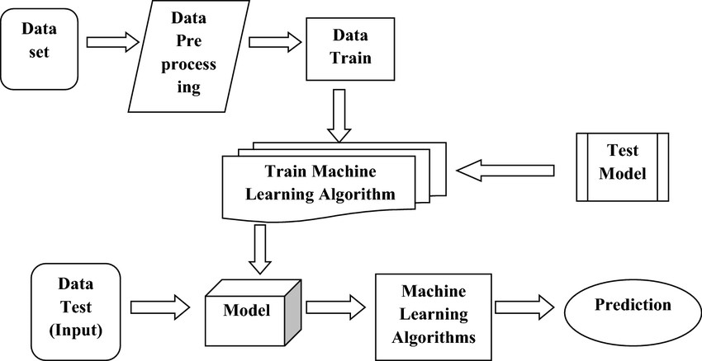
Architecture
Flow Diagram

Slide 9
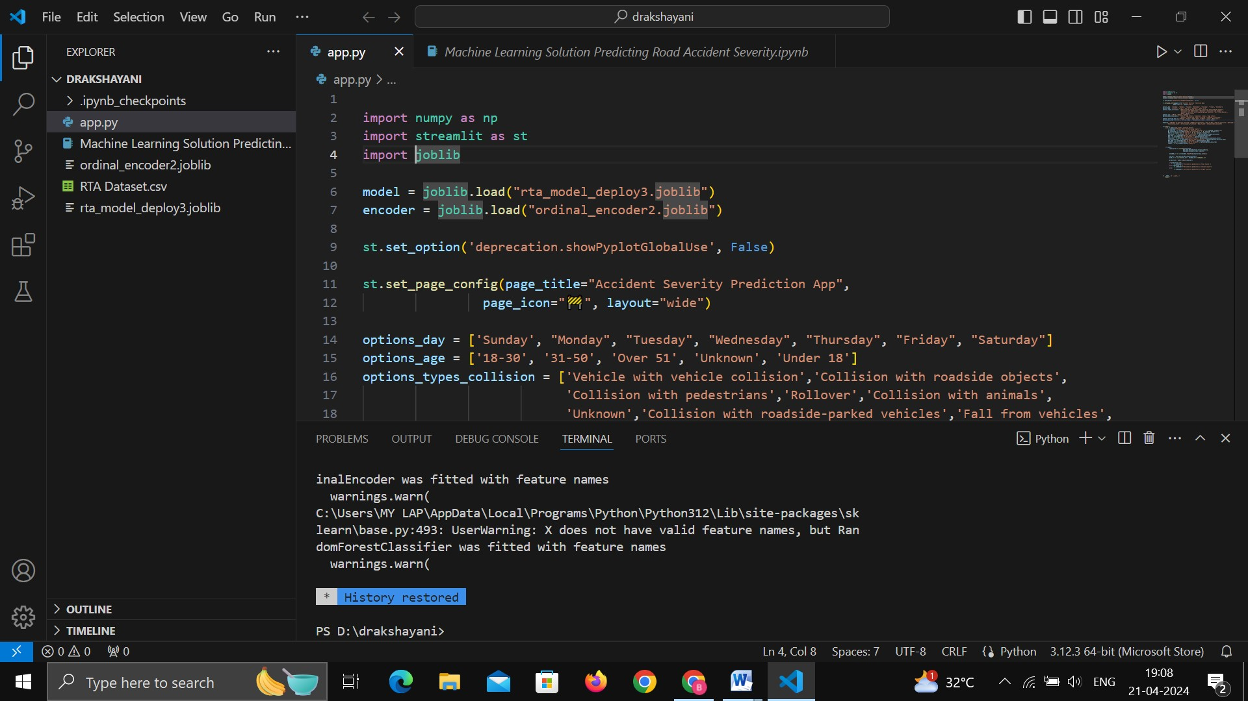
Screen shots:

Slide 10
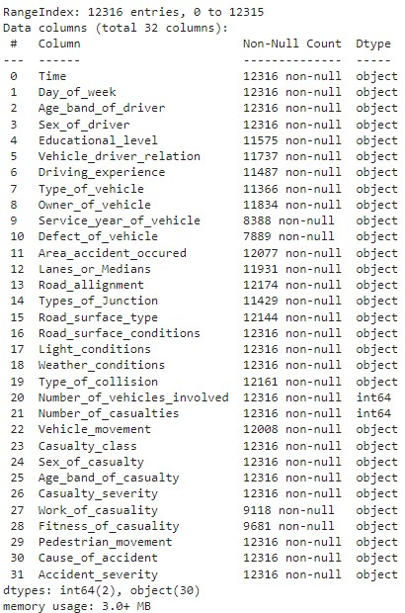
Data set

Slide 11
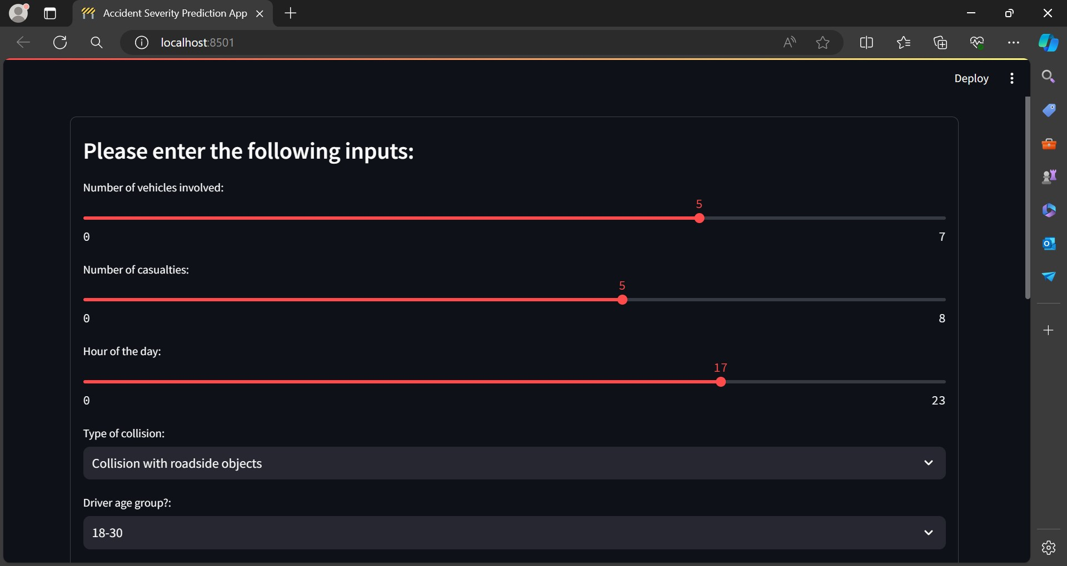
prediction

Slide 12
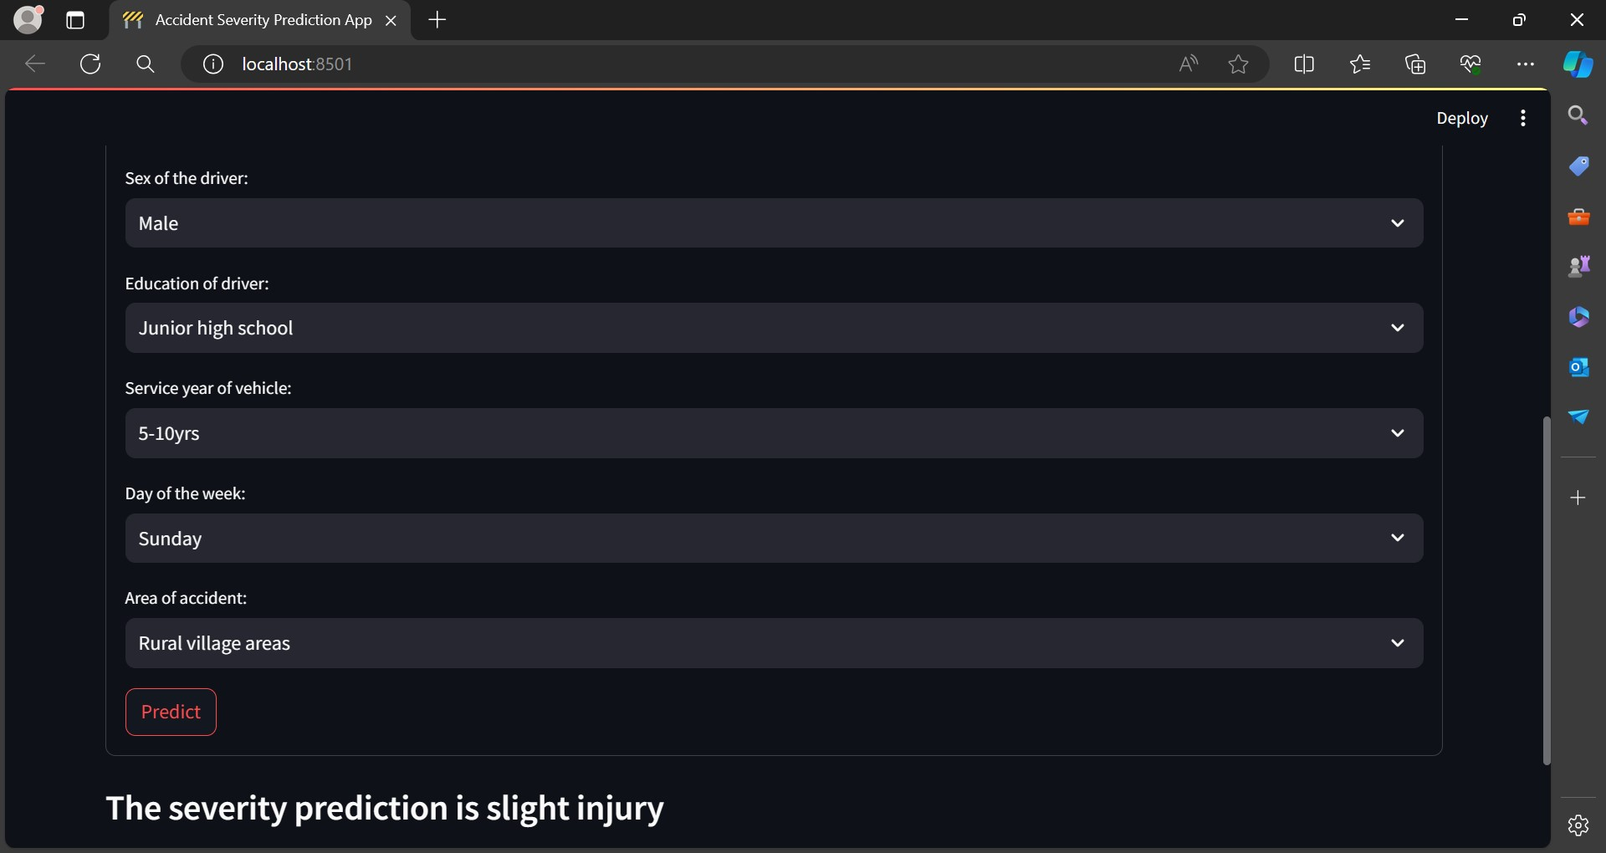

Slide 13
Conclusion
In conclusion, the end-to-end data science and machine learning project successfully presented the potential for using data analysis and prediction to aid in the prevention of road accident fatalities. By thoroughly analyzing the provided data and training a machine learning model to predict the severity of potential accidents, the investigation agency can prioritize its efforts and resources toward the most high-risk situations. This project highlights the value of using data-driven approaches to address complex problems and the importance of continued investment in these initiatives. Let’s look at the key takeaways from this article.

